Slide 1
HTML

Slide 2
HTML
Short for Hyper Text Markup Language, the language used to create documents on the World Wide Web.
HTML was invented by Tim Berners-Lee while at CERN, the European Laboratory for Particle Physics in Geneva.

Slide 3
HTML Versions
Version | Year
HTML | 1991
HTML+ | 1993
HTML 2.0 | 1995
HTML 3.2 | 1997
HTML 4.01 | 1999
XHTML | 2000
HTML5 | 2012

Slide 4
HTML
Hyper Text Markup Language
  Hypertext – Dealing with links
  Markup – Designing documents with some tags, styles or lay outs
Softsmith Infotech

Slide 5
HTML: What do you need?
Editor (Notepad)
Browser to view results
Place to put your web sit (store the files that contain the HTML code, images, music, etc.), preferably on the internet
URL for your page (domain name, or folder within a domain) → if your page is on the Internet

Slide 6
Tags
A tag is a unit of markup, start with a less-than sign (<) followed by a keyword and concluded or ended with a greate-then sign (>). The symbol great-than and less-than are called angle brackets.

Slide 7
HTML Elements
An HTML element usually consists of a start tag and end tag, with the content inserted in between:
<tagname>Content</tagname>
The HTML document begins with <html> and ends with </html>.

Slide 8
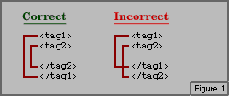
HTML tags
Case insensitive
Unrecognised tags are simply ignored by browser!!
Container tags must be nested!!

Slide 9
HTML Tags
Paired Tags
Unpaired Tags

Slide 10
Paired Tags
A tag is said to be a paired tag if the text is placed between a tag and its companion tag.
In paired tags, the first tag is referred to as Opening Tag and the second tag is referred to as Closing Tag.
Example of Paired Tags in HTML:
<p>Paragraph</p>

Slide 11
Unpaired Tags
An unpaired tag does not have a companion tag. Unpaired tags are also known as Singular tags or Stand-Alone Tags.
Example of Unpaired Tags in HTML:
<br> <img src='test.png' >

Slide 12
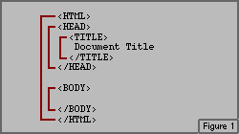
Structure of HTML document
Basic structure:

Slide 13
Structure of the web page
Inside the <html></html> tag
  Each web page has a body part described in <body></body> tag:
<html>
<head>
<title> CGS 2100 </title>
</head>
<body>
This is a sample HTML file.
</body>
</html>
The content of the whole web page should be put here

Slide 14
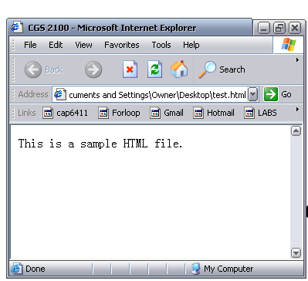
Title
Body

Slide 15
HTML Creation
Use Notepad or any text editor
Type contents and save with a .htm or .html extension
Eg. MyPage.html
FrontPage, MS Word allows us to create web pages without any prior knowledge in HTML. Just save as web page and you will get the effect.
Softsmith Infotech

Slide 16
HTML <!--Type your comment--> Tag
<!--This is a comment. Comments are not displayed in the browser-->

Slide 17
Body Tag - Attributes
Attribute | Value | Description
background | URL | Specifies a background image for a document
bgcolor | color | Specifies the background color of a document
text | color | Specifies the color of the text in a document
link | color | Specifies the color of unvisited links in a document
vlink | color | Specifies the color of visited links in a document
alink | color | Specifies the color of an active link in a document

Slide 18
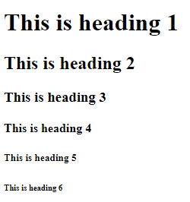
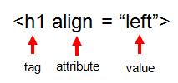
H1-h6
The six different HTML headings:
<h1>This is heading 1</h1> largest
<h2>This is heading 2</h2>
<h3>This is heading 3</h3>
<h4>This is heading 4</h4>
<h5>This is heading 5</h5>
<h6>This is heading 6</h6> smallest
Attributes:
Attribute | Value | Description
align | left center right justify | Specifies the alignment of a heading

Slide 19
Img tag
Attribute | Value | Description
src | URL | Specifies the URL of an image
alt | text | Specifies an alternate text for an image
align | top bottom middle left right | Specifies the alignment of an image according to surrounding elements
border | pixels | Specifies the width of the border around an image
height | pixels | Specifies the height of an image
width | pixels | Specifies the width of an image
ismap | ismap | Specifies an image as a server-side image-map
usemap | #mapname | Specifies an image as a client-side image-map
<img border=“5" src="buttonnext.gif" width="65" height="38">

Slide 20
Hr tag
Attribute | Value | Description
align | left center right | Specifies the alignment of a <hr> element
noshade | noshade | Specifies that a <hr> element should render in one solid color (noshaded), instead of a shaded color
size | pixels | Specifies the height of a <hr> element
width | pixels% | Specifies the width of a <hr> element

Slide 21
P tag
<p>This is some text in a paragraph.</p>
Attribute | Value | Description
align | left right center justify | Specifies the alignment of the text within a paragraph

Slide 22
Font tag
Attribute | Value | Description
face | font_family | Specifies the font of text
size | number | Specifies the size of text
color | rgb(x,x,x) #xxxxxx colorname | Specifies the color of text
<font size="3" color="red">This is some text!</font>
<font size="2" color="blue">This is some text!</font>
<font face="verdana" color="green">This is some text!</font>

Slide 23
Center tag
You can use <center> tag to put any content in the center of the page.

Slide 24
Revision
Tag | Description
<html> | Defines an HTML document
<body> | Defines the document's body
<h1> to <h6> | Defines header 1 to header 6
<p> | Defines a paragraph
<br> | Inserts a single line break
<hr> | Defines a horizontal rule
<!--> | Defines a comment

Slide 25
Example HTML code:
      <HTML>
      <head>
      <title>Hello World</title>
      </head>
      <body bgcolor = “#000000”>
      <font color = “#ffffff”>
      <H1>Hello World</H1>
      </font>
      </body>
      </HTML>

Slide 26
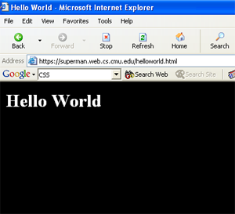

Slide 27
HTML Exercise
Create a Personal homepage
Design an E-Greeting page which has properly aligned paragraphs with images

Slide 28
Text Formatting Tags
Tag | Description
<b> | Defines bold text This text is bold.
<big> | Defines big text
<em> | Defines emphasized text This text is emphasized.
<i> | Defines italic text This text is italic.
<mark> | displayed as marked with yellow ink This text is italic.
<small> | Defines small text
<strong> | Defines strong text This text is strong.

Slide 29
Tag | Description
<sub> | Defines subscripted text This is _{subscripted} text.
<sup> | Defines superscripted text This is ^{superscripted} text.
<ins> | Defines inserted text text
<del> | Defines deleted text
<s> | Deprecated. Use <del> instead
<strike> | Deprecated. Use <del> instead
<u> | Deprecated. Use <ins> instead

Slide 30
COMMONLY USED CHARACTERS
Result | Description | Entity Name
 | non-breaking space | &nbsp;
< | less than | &lt;
> | greater than | &gt;
& | ampersand | &amp;
¢ | cent | &cent;

Slide 31
Result | Description | Entity Name
£ | pound | &pound;
¥ | yen | &yen
€ | euro | &euro;
§ | section | &sect;
© | copyright | &copy;
® | registered trademark | &reg;
 | Rupees | &#8377;

Slide 32
Color Codes
WHITE
BLACK
RED
GREEN
BLUE
MAGENTA
CYAN
YELLOW
AQUAMARINE
BAKER’S CHOCOLATE
VIOLET
BRASS
COPPER
PINK
ORANGE
#FFFFFF
#000000
#FF0000
#00FF00
#0000FF
#FF00FF
#00FFFF
#FFFF00
#70DB93
#5C3317
#9F5F9F
#B5A642
#B87333
#FF6EC7
#FF7F00

Slide 33
Color Codes
If you require more information about color values, there is an excellent site entitled “VGDesign’s Interactive Color Cube” that displays the background color code when you put your cursor over a small color sample. The Web address is :
http://www.vgdesign.com/color.html

Slide 34
Marquee tag
Attribute | Value | Description
behavior | scroll slide alternate | Defines the type of scrolling.
bgcolor | rgb(x,x,x) #xxxxxx colorname | Deprecated − Defines the direction of scrolling the content.
direction | up down left right | Defines the direction of scrolling the content.
height | pixels or % | Defines the height of marquee.
hspace | pixels | Specifies horizontal space around the marquee.
loop | number | Specifies how many times to loop. The default value is INFINITE, which means that the marquee loops endlessly.
scrolldelay | seconds | Defines how long to delay between each jump.
scrollamount | number | Defines how how far to jump.
width | pixels or % | Defines the width of marquee.
vspace | pixels | Specifies vertical space around the marquee.

Slide 35
address
The <address> tag defines the contact information
The text in the <address> element usually renders in italic.
Most browsers will add a line break before and after the address element.
<address>
Visit us at:<br>
Example.com<br>
Box 564, Disneyland<br>
USA
</address>

Slide 36
anchor tag
The <a> tag defines a hyperlink, which is used to link from one page to another.
The most important attribute of the <a> element is the href attribute, which indicates the link's destination.
By default, links will appear as follows in all browsers:
An unvisited link is underlined and blue
A visited link is underlined and purple
An active link is underlined and red
<a href="http://www.w3schools.com">Visit W3Schools.com!</a>

Slide 37
anchor tag attributes
href | URL | Specifies the URL of the page the link goes to
download | filename | Specifies that the target will be downloaded when a user clicks on the hyperlink
target | _blank _parent _self _top framename | Specifies where to open the linked document

Slide 38
An Image as a Link
<!DOCTYPE html>
<html>
<body>
<p>
An image as a link: <a href="http://www.w3schools.com">
<img border="0" alt="W3Schools" src="logo_w3s.gif" width="100" height="100">
</a>
</p>
</body>
</html>

Slide 39
Text as Hyper reference
<A HREF="APP.HTML">CLICK HERE </A>
Button as Hyper reference
<A HREF="APP.HTML"><button>Click me</button></A>
Image as Hyper reference
<A HREF="APP.HTML"><IMG SRC="sweet-home-icon.jpg"></A>

Slide 40
H1 ALIGN="CENTER">SAFETY TIPS FOR CANOEISTS</H1>
<OL TYPE=“a” START=“2”>
<LI>Be able to swim </LI>
<LI>Wear a life jacket at all times </LI>
<LI>Don't stand up or move around. If canoe tips,
  <UL>
  <LI>Hang on to the canoe </LI>
  <LI>Use the canoe for support and </LI>
  <LI>Swim to shore
  </UL> </LI>
<LI>Don't overexert yourself </LI>
<LI>Use a bow light at night </LI>
</OL>

Slide 41
What will be the output?
<

Slide 42
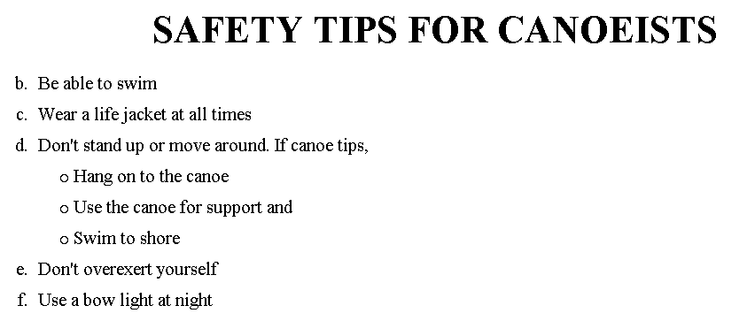
The output….

Slide 43
<H1 ALIGN="CENTER">SAFETY TIPS FOR CANOEISTS</H1>
<OL TYPE="a" START="2">
<LI>Be able to swim </LI>
<LI>Wear a life jacket at all times </LI>
<LI>Don't stand up or move around. If canoe tips,
<UL>
<LI>Hang on to the canoe </LI>
<LI>Use the canoe for support
<OL type="I" start="4">
<LI> Be careful </LI>
<LI> Do not look around</LI>
</LI> </OL>
<LI>Swim to shore
</UL> </LI>
<LI>Don't overexert yourself </LI>
<LI>Use a bow light at night </LI>
</OL>
What
will
be the
output?

Slide 44
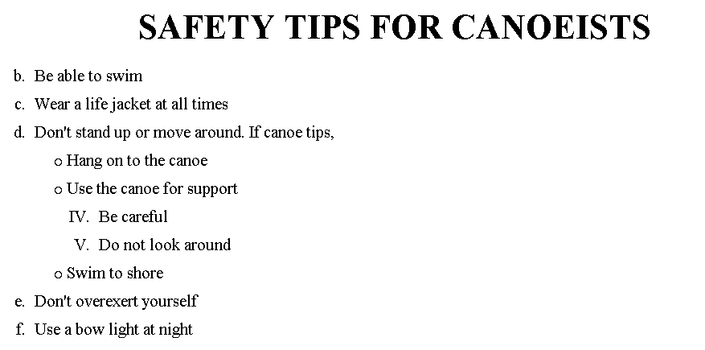
The output….

Slide 45


